Slide 1


Slide 2
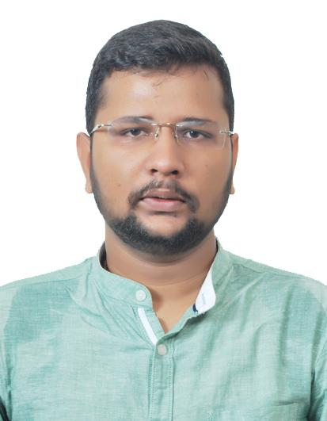
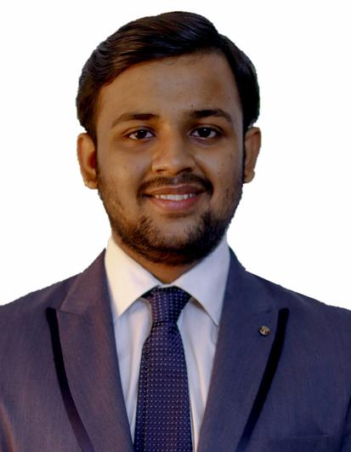
Project Highlights
Project Name : Web Development
Team Size : 2
BU Mentor Name : Raghavendra Prasad CS Mentor PS#
Tarun Choudhary
PS#99002554
2009BLRICP01
B.Tech ICE
Team Player
Suraj Marthy
PS#99002535
2009BLRICP01
B.Tech EEE
Self Driven, Team Player

Slide 3

Project Video Snippet

Slide 4
Future development that can be implemented further
Product portfolio can be improved further
Product web pages could be added onto the website
Clientele in any could be included.
Dynamic images and UI improvement could be done

Slide 5
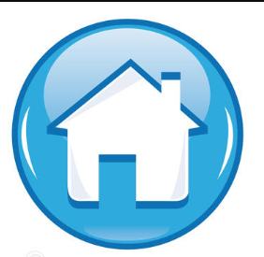
Thank You !

